Slide 1

DEEP LEARNING

Slide 2

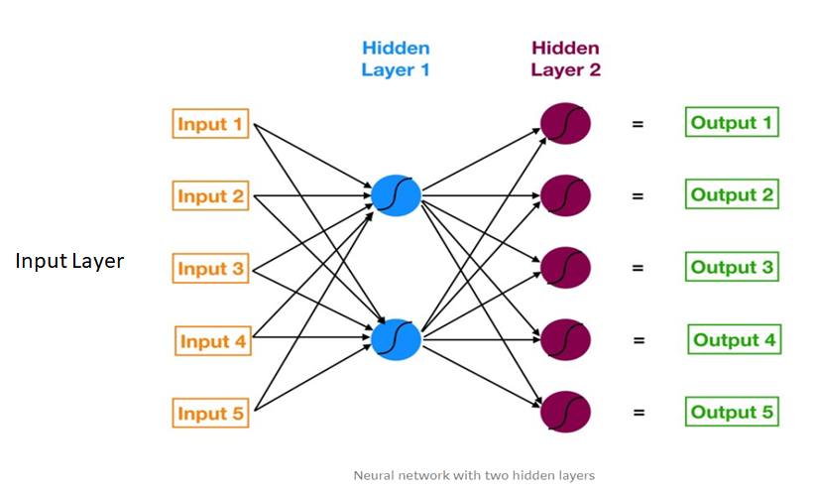
NEURAL NETWORKS - BASIC ARCHITECTURE
Architechture of a neural network
Features are fed to the model as input (just like in any other model)

Slide 3
NEURAL NETWORKS - BASIC ARCHITECTURE
Outputs are defined given the problem
and the network will return the
probability of each class
(in classification problems)

Slide 4
NEURAL NETWORKS - BASIC ARCHITECTURE
Characteristics of the network:
Several Neurons
Spread across different layers
All connected by weights

Slide 5
Checkout this demo…
DEMO
Notes:
https://playground.tensorflow.org/#activation=tanh&batchSize=10&dataset=circle&regDataset=reg-plane&learningRate=0.03&regularizationRate=0&noise=0&networkShape=4,2&seed=0.78362&showTestData=false&discretize=false&percTrainData=50&x=true&y=true&xTimesY=false&xSquared=false&ySquared=false&cosX=false&sinX=false&cosY=false&sinY=false&collectStats=false&problem=classification&initZero=false&hideText=false

Slide 6
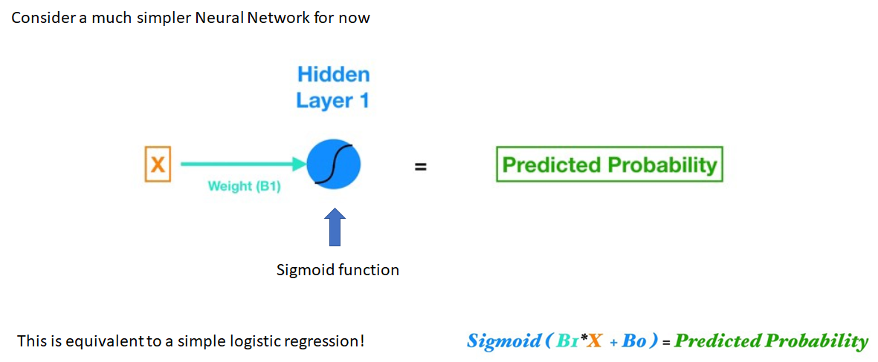
NEURAL NETWORKS - NEURONS
Considering a much simpler Neural Network, just one neuron, just one input
The input is given a relative importance represented by the weight
The weight*input is then passed to the neuron
The neuron has an activation function (sigmoid in this case) that usually "triggers" at some input treshold
Probability is returned - sometimes just activation

Slide 7
NEURAL NETWORKS - NEURONS
Considering a much simpler Neural Network, just one neuron, just one input
This is equivalent to a logistic regression!

Slide 8
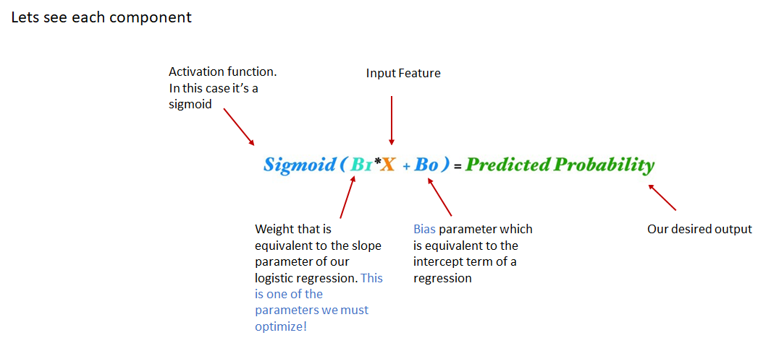
NEURAL NETWORKS - NEURONS
Writing down each term in a way that is familiar to us fom logistic regression

Slide 9
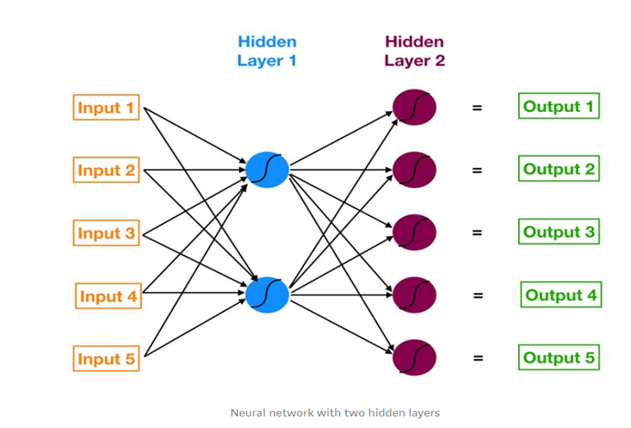
NEURAL NETWORKS
Going back to our full Neural Network we see that it is made up multiple layers of this components. Multiple Layered Neurons

Slide 10
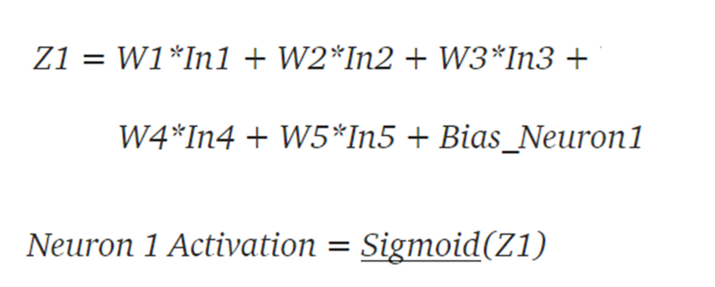
NEURAL NETWORKS - HOW DOES IT WORK?

Slide 11
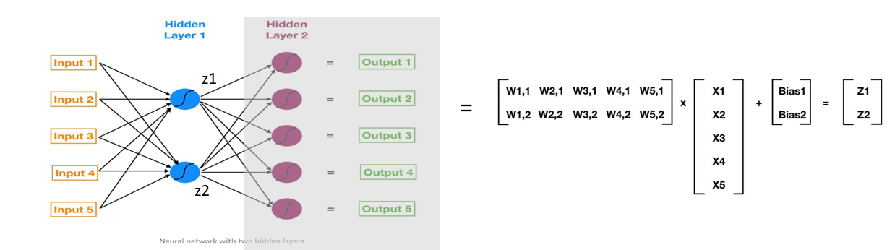
NEURAL NETWORKS - HOW DOES IT WORK?
Or as a matrix form

Slide 12
NEURAL NETWORKS - HOW DOES IT WORK?
Or as a matrix form
Inputs

Slide 13
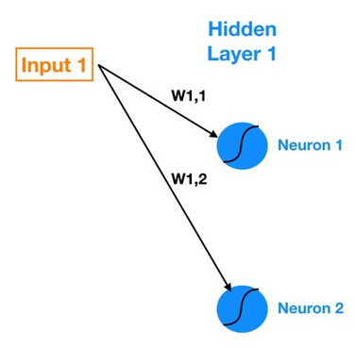
NEURAL NETWORKS - HOW DOES IT WORK?
Or as a matrix form
weights from inputs to neurons
Inputs

Slide 14
What is an Activation Function?
An activation function decides whether a neuron should be activated or not.
Introduces non-linearity to the neural network, enabling it to learn complex patterns.
Without activation functions, the neural network behaves like a linear regression model.
Allow neural networks to model non-linear relationships.
Control the output range of the neuron.

Slide 15
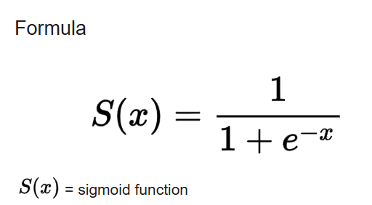
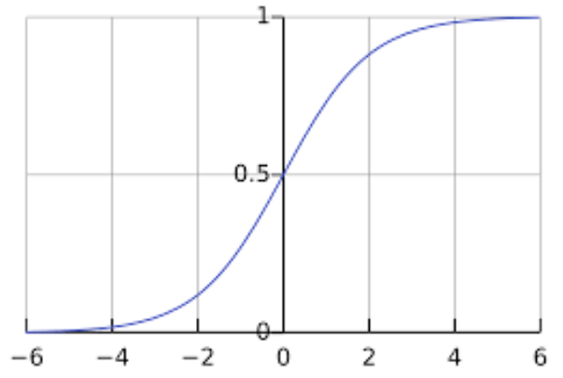
Common Activation Functions
Sigmoid
Use case:
Binary classification

Slide 16
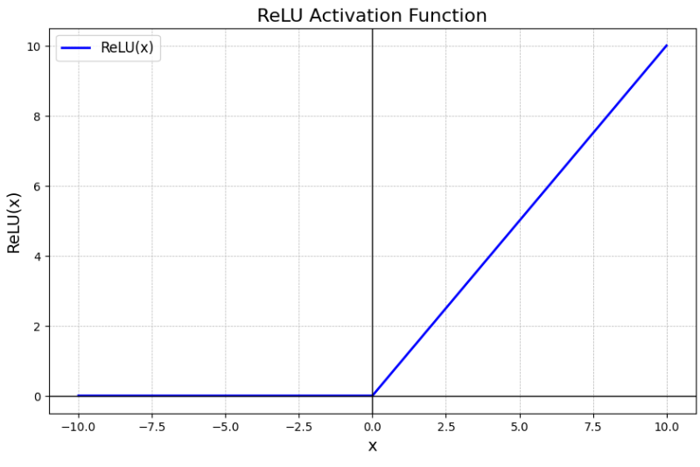
Common Activation Functions
ReLU (Rectified Linear Unit)
ReLU(x)= max(0,x)
Use case:
hidden layers

Slide 17
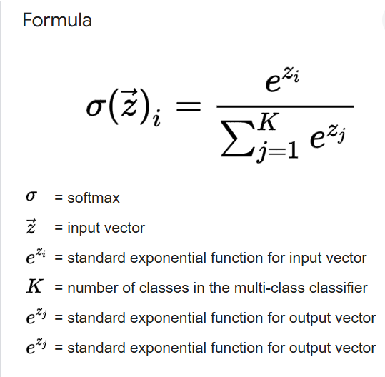
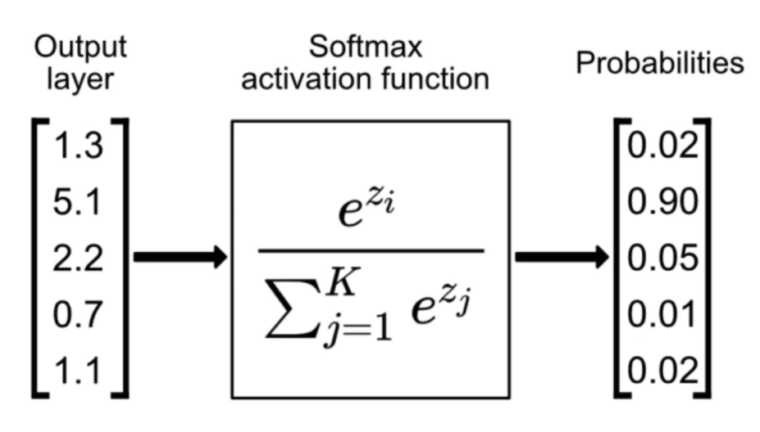
Common Activation Functions
Softmax
Cannot be shown as a simple 2D curve like sigmoid because it acts on vectors. But it distributes "probabilities" across all inputs.
Use case:
Multi-class classification

Slide 18
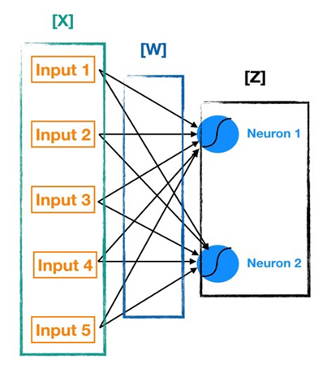
NEURAL NETWORKS - HOW DOES IT WORK?
Given a set of inputs and weights we can therefore move throughout the neural network calculating the outputs of all the corresponding neurons. This is known as forward propagation and it allows us to compute the output of the network

Slide 19
NEURAL NETWORKS - HOW DOES IT WORK?
The steps are:
Define a cost function
Minimize it by fine-tuning the parameters and comparing predictions with the training data

Slide 20
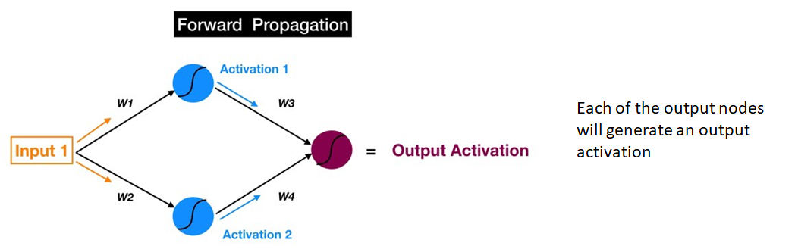
NEURAL NETWORKS - HOW DOES IT WORK?
With forward propagation each of the output nodes will generate an output activation

Slide 21
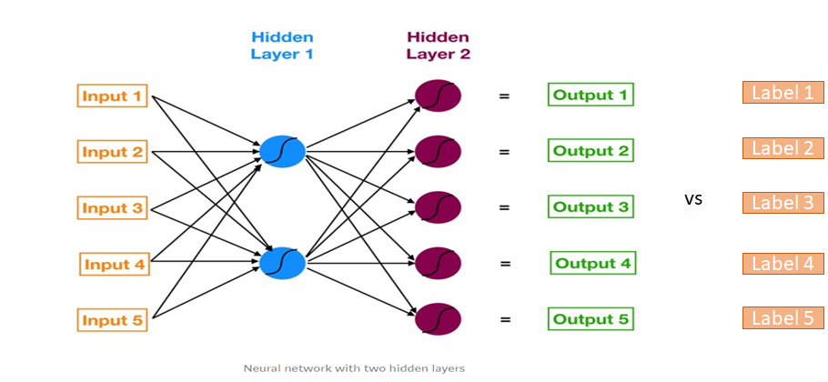
NEURAL NETWORKS - BUT WHERE IS THE LEARNING?
The learning process consists of comparing the outputs obtained with the labels of the training data.

Slide 22
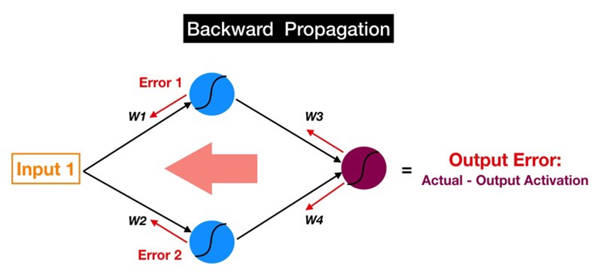
NEURAL NETWORKS - BACKPROPAGATION
The Training process for a neural network occurs by now going back in the network and tweak the weights and biases of each layer. This process is called Back-Propagation
Going back through the network all the way until the inputs means that all weights were updated.
But how do we update each weight?

Slide 23
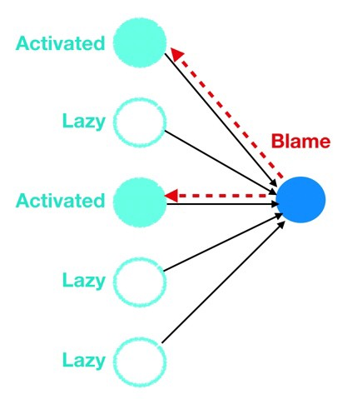
NEURAL NETWORKS - BACKPROPAGATION
When the error gets back propagated to a particular neuron, that neuron will quickly and efficiently point the finger at the upstream colleague (or colleagues) who is most at fault for causing the error (i.e. layer 4 neurons would point the finger at layer 3 neurons, layer 3 neurons at layer 2 neurons, and so forth).
The Blame Game

Slide 24
NEURAL NETWORKS - BACKPROPAGATION
The larger the error, the more the neuron decreases its own bias
The larger the error, the more blame the neuron points back to force upstream colleagues to decrease their own biases
The more input the neuron receives from the upstream colleague, more it lowers the weight of the link from that colleague
The Blame Game - effects

Slide 25
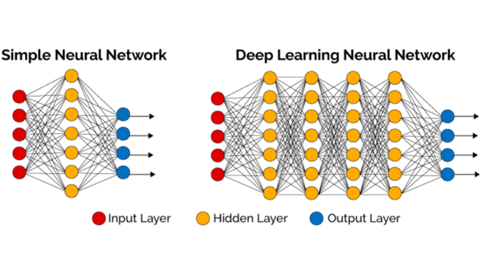
NEURAL NETWORKS & DEEP LEARNING

Slide 26
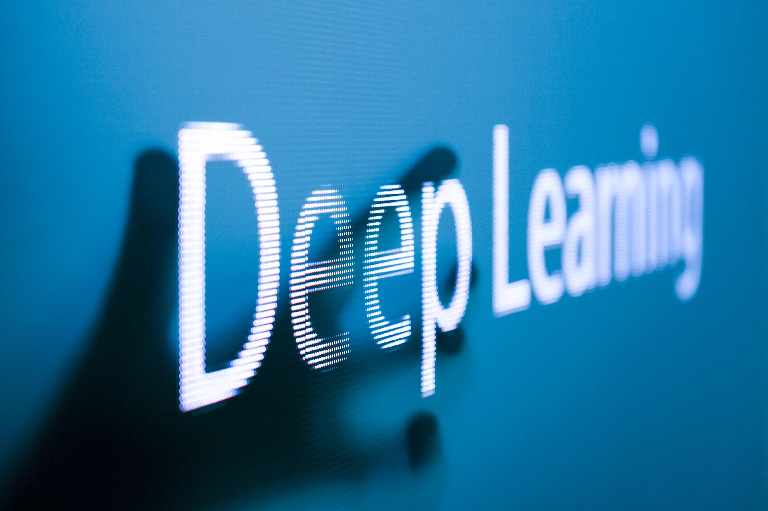
PROBLEMS WITH DEEP LEARNING
Model Interpretability
Due to the complex nature of the networks and multiple parameters/layers, we have little or no intuition regarding why the model performs as it does.
Cost
The sheer number of free parameters required to optimize, combined with the fact that large amounts of data are required, means that the "bill" will be quite heavy

